Slide 1

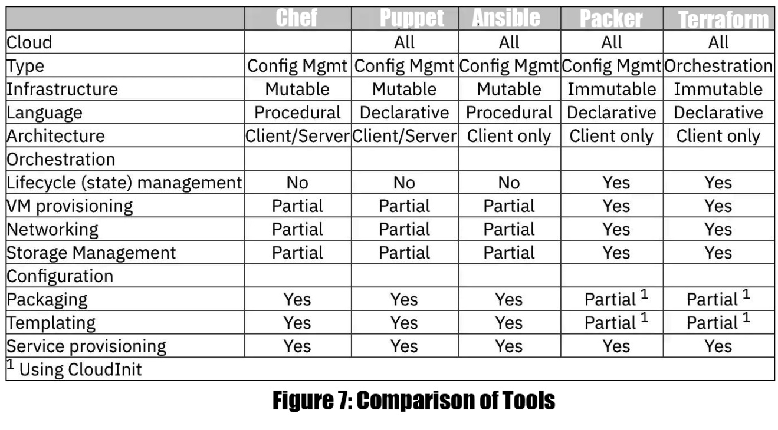
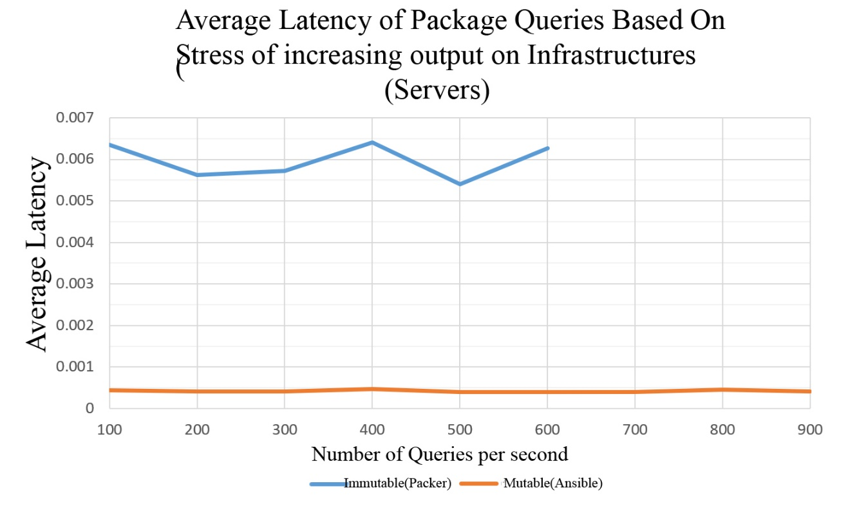
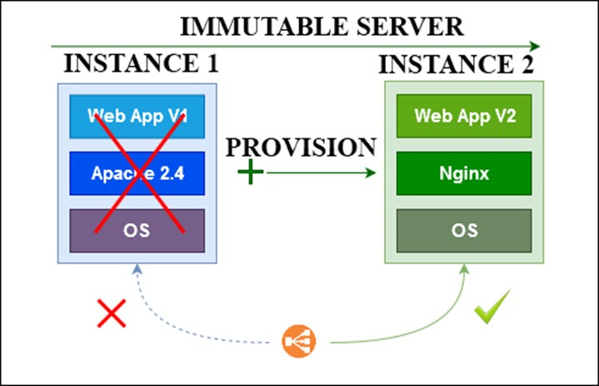
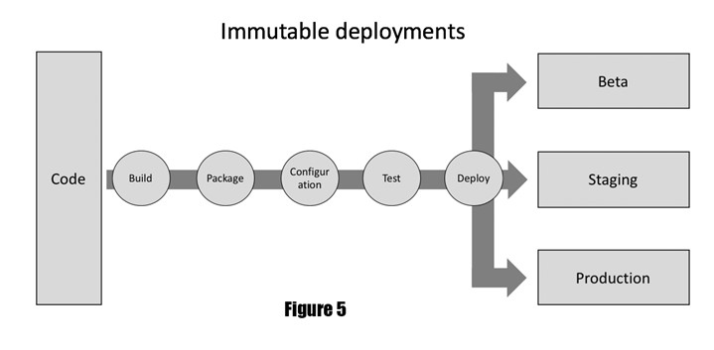
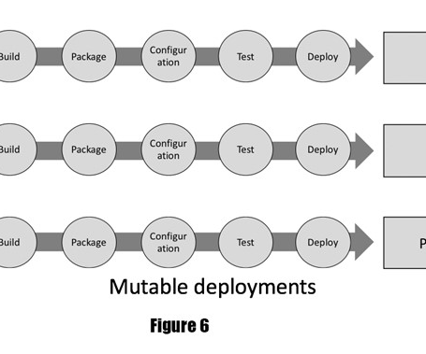
Automated Generation of Virtual Machine Images with Hasicorp Packer
Necati Hasan Turan 1101020051
Yaren Mısırlı 1600001547
Işıl Alıcı 1600002106
Project Advisor: Prof. Dr. Murat Taylı
Department of Computer Engineering
2020-2021 Fall
Project Description
This project aims to show every capability of Packer by creating and launching machine images on AWS EC2 platform while showing how long it can take without packer.
While we show other techniques and their capacities, we will also show how easy it could with only using Packer as a helping tool to organize whole infrastructure for our services and applications.
We used Immutable Infrustructure to prove our point we compare with other concepts like Mutable Infrustructure or monolith systems.
When we try to deploy a series of apps, configurations and services for a certain aim on an instance of a virtual image, it will take longer time to make it ready for work and do exact setting of our desired purpose.
We, developers always want to automate the system so DevOps teams can easily maintain and alter each time we need to be interact with our serversDevOps is an collective&extensive concept which reduces the blockage between development teams and operational staff to make a continuous and fast delivery and allow precise&fast reactions to evolving necessities in the infrastructure development cycles.
Developing applications, running them and their applications needs to be established as IaaS,PaaS or as Monolithic traditional service.
This paper will be showed on the AWS EC2 platforms. Then, with the Packer’s abilities and components we will look at how we can do all of these manual configuration with an only a JSON file remotely.
Design Summary
Implementation Summary
Creating a immutable server with Packer requires a cloud service account so we used EC2 AMIs for this reason. After creating an account, we have used VS Code for creating Packer components so we create .SH files for Shell commands, JSON files for Packer components and finally HTML files for using NGINX server with only Packer.
For installation of Packer, we have used Chocolatey tool on Windows 10 platform. Powershell helped us to used both Windows and ubuntu terminal.
Since we connect our cloud by SSH, we have used PuTTY ssh configuration tool. Also we needed to use WinRM (Windows Remote Management) to handle Windows virtual machine images on EC2 to create a custom pre-baked Windows server.
We have also used Ansible,Chef,Puppet and Terraform just to compare these tool with Packer.
First, we will talk about virtual images, immutable and mutable infrustructures and then we will talk about types of virtual images. Then we will give a basic report about Amazon AWS ecosystem. Then we will talk about Hashicorp ecosystem.
Finally we will take look at Packer, it’s capabilities and components. In the methodology section, all parts of the our whole work and the Packer itself will be completely explained and showed.
On the part of 5, the project with similar works has been examined and the evaluations are presented in a table.
In the experimental results section, the studies and observations made to achieve the targeted results are included.
The data obtained as a result of these experiments are presented below with figures and tables. In the discussion part, the procedures and findings obtained from the experiments were evaluated and the ideas were given. In the conclusion part, a short description of the project and future ideas are given.
Results and Discussion
In The Automated Generation of Virtual Machine Images with HasiCorp Packer project aimed the change the notion of using infrastructure of the software deployment and tried to reduce significant amount of time and cost of the general develop-configure-deploy phase of the systems that happene to be installed on local deviceso or cloud based systems like AWS,Azure or Digital Ocean. With these concept of the deployment we automated the system of creation of the VMs and its configurations with the each phases of the required cycle of the generations VMs and secondary/third party applications.
Table 1. Comparison of Immutable vs Mutable.
Figure 1. Immutable Server
Figure 2. Immutable Deployments
Figure 3. Mutable Deployments

